Slide 1
WORLD CLOCK
JAVA PROJECT
Presented by:
Sukhjot Kaur
Divya
Anushka Mahajan

Slide 2
Introduction
A world clock is a tool that displays the current time in different time zones around the world, making it easier to keep track of time in different regions.
In this project, we have developed a Java-based world clock that displays the time in different regions based on the location of the mouse pointer on a world map.
The application allows users to move the mouse cursor over the map image to highlight a specific location and display the current time in that location.

Slide 3
Language Used
JAVA : Java is a widely used programming language for developing various types of applications. In the case of the World Clock project, Java is used to create a user-friendly interface.
API USED :
• Swing
• Date Time
• Awt

Slide 4
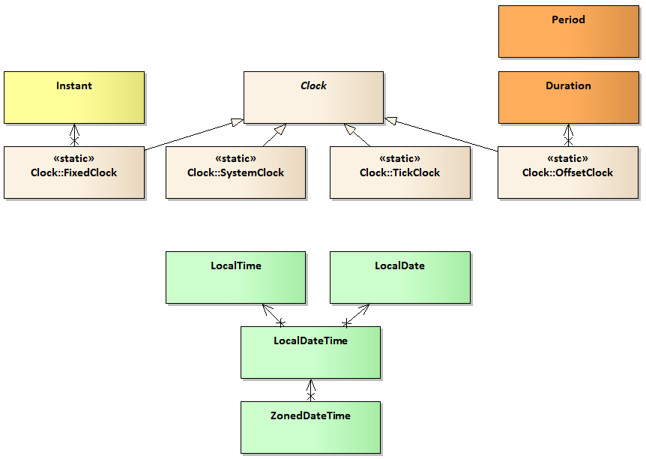
Date Time API
The Date-Time APIs, introduced in JDK 8, are a set of packages that model the most important aspects of date and time.

Slide 5
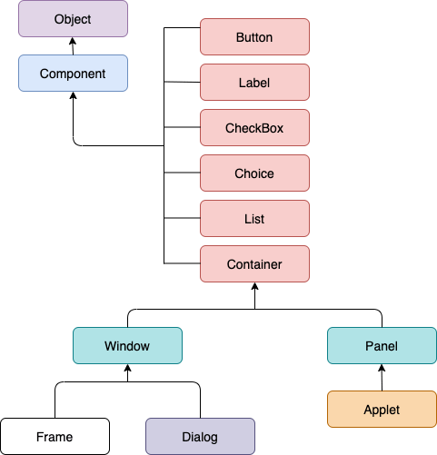
AWT API
AWT stands for Abstract window toolkit is an Application programming interface (API) for creating Graphical User Interface (GUI) in Java. It allows Java programmers to develop window-based applications.

Slide 6
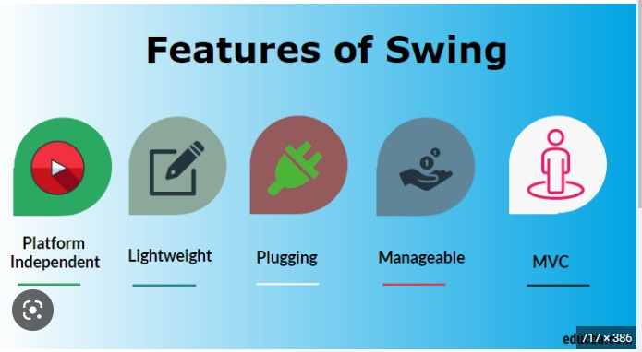
SWING API
Swing API is a set of extensible GUI Components to ease the developer's life to create JAVA based Front End/GUI Applications. It is build on top of AWT API and acts as a replacement of AWT API, since it has almost every control corresponding to AWT controls.

Slide 7
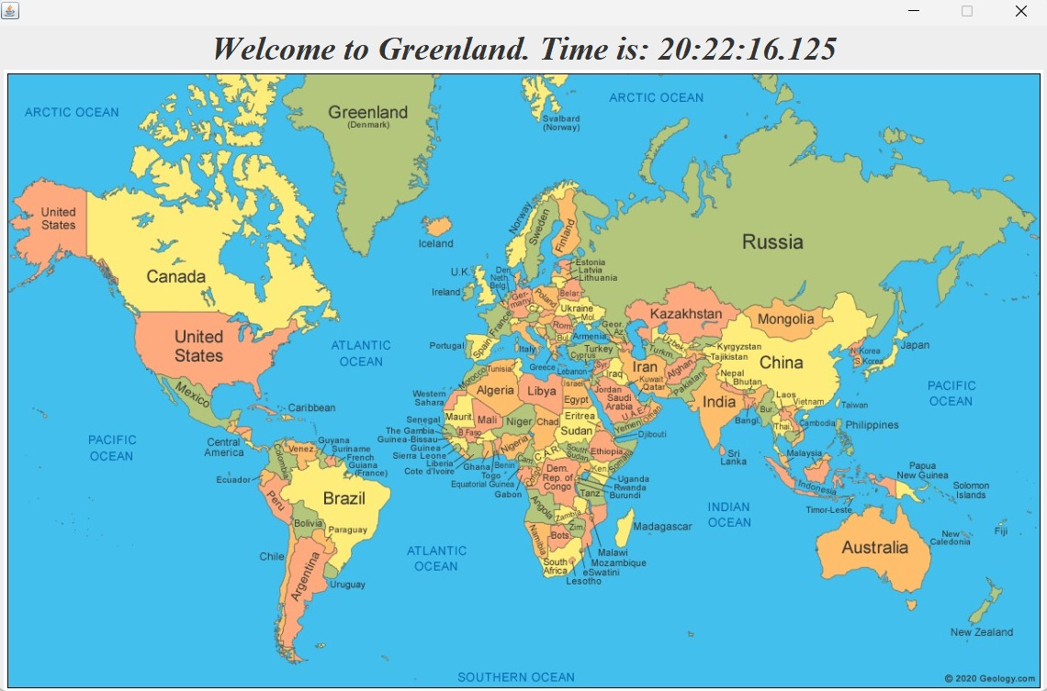
EXECUTION

Slide 8
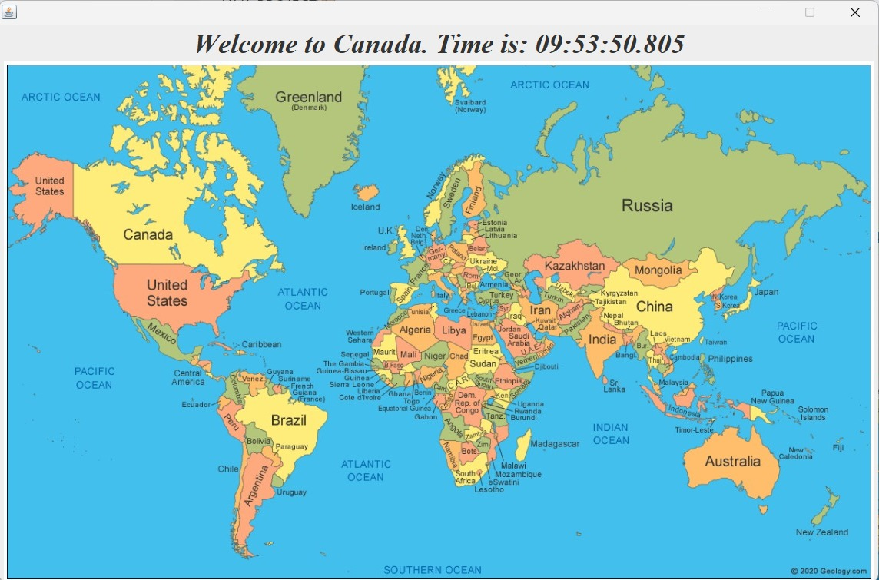

Slide 9


Slide 11
BIBLIOGRAPHY
https://www.oracle.com/in/java/
https://www.geeksforgeeks.org/
https://geology.com/world/world-map.shtml
https://www.timeanddate.com/time/current-number-time-zones.html

Slide 12
THANK YOU

